Slide 1

Team Los Pollos Locos presents
Notes:
Hackathon Team Los Pollos Locos presents…

Slide 2
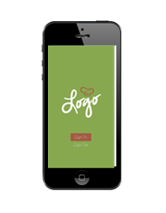
The Cater U app
Notes:
The “Cater U” app from Ungerboeck.

Slide 3
Personalizable
Notes:
A personalizable app…(swap out generic app with Microsoft app)

Slide 4

Catering company icon
Venues icon
Other businesses icon
Catering icon
Notes:
…that allows catering companies, venues, and a whole host of other businesses to provide quick and easy catering services to their customers.

Slide 5

Seriously! Go sell it NOW!
Notes:
The best part? It leverages existing Ungerboeck Software architecture so it’s ready to sell right now!
SERIOUSLY! Go sell it! NOW!

Slide 6
Let’s see how it works…
Notes:
Let’s see how it works…

Slide 7



Bill
$
Notes:
This is Bill. He’s a Microsoft employee working on a $20 billion project, and he needs to grab a quick lunch on his way to a meeting.

Slide 8

Notes:
Luckily for Bill, Microsoft has the Cater U app so he can expedite the process of getting the lunch he wants from the campus cafeteria.

Slide 9
Notes:
Check it out…
(Zoom in on phone – walk though demo)
Click on icon for app and land on “Sign in/up” page
Click “Sign in” button and land on “Sign in page”
Enter credentials, and land on “For delivery or pickup” page
When delivery is clicked, land on “Delivery location” page that shows all spaces
After space is selected, land on “Delivery date/time” page
After deliver date/time is selected, land on “Overall menu category listing” page (resource type) which will have menu item categories like salads, sandwiches, etc.
Upon click of a menu category, a list of all available menu items displays on a “Specific menu category listing” page (or should this be a collapsible list vs. individual pages that require the user to hit a back button to access the overall menu category listing page?)
When a menu item is selected, land on “Menu item detail” page or pop up
After menu item quantity is selected, user clicks on a cart icon and lands on “Order confirmation” page that contains payment type options
After order is placed, a “Thank you for your order” page is displayed with order number and option to start over

Slide 10
Include screen shot of software – the Ali Farooqui contact record screen with service orders tab displayed
Notes:
The cool thing is that all the data flows into Ungerboeck real time to be serviced by catering staff.

Slide 11
Notes:
Bill is so happy! He made the deadline on a full stomach!

Slide 12
Create an account
Look at order history
Process payments in real time
Send email confirmation
Allow for bundles, packages with substitutions, upsells
Set maximums and minimums on quantities of order items
Be sold as part of the event management suite or as a stand-alone product offering powered by a streamlined version of Ungerboeck Software
Notes:
So what else can this thing do?
Create an account
Look at order history
Process payments in real time
Send email confirmation
Allow for bundles, packages with substitutions, upsells
Set maximums and minimums on quantities of order items
Be sold as part of the event management suite or as a stand-alone product offering powered by a streamlined version of Ungerboeck Software

Slide 13
Catering company icon
Notes:
It’s good for catering companies!

Slide 14
Staff
Hospital icon
Catering company icon
University icon
Students
Corporation icon
Patients
Government icon
Notes:
Their customers could include hospitals, universities, corporations, government entities, and more! Their end users could include staff, students, patients, and so on!

Slide 15


Notes:
It could be used for when a loved one is in the hospital and you want to send a care basket. You just go to the app and order a gift basket for delivery to their room. They may have a thermometer in their mouth at the time, but they’ll manage a smile!

Slide 16



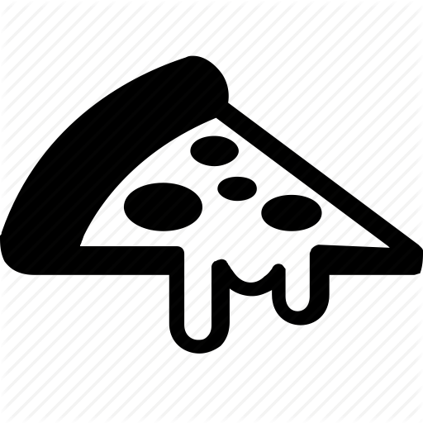
Notes:
Or perhaps your first born is at college and you want to send a birthday basket to their dorm room! Simply go to the app and order a present for delivery to their dorm. They’ll put the pizza and beer down long enough to accept the gift and do a happy dance!

Slide 17
Venue icon
Stadium icon
Attendee
Arena icon
Notes:
Or think about how venues could use it! It’s ideal for stadiums and arenas!

Slide 18

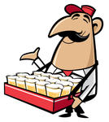

Notes:
Patrons could use the app to order food right to their seat and never miss a minute of the game!

Slide 19
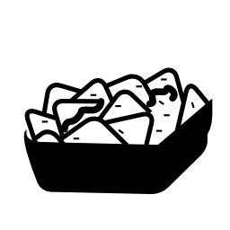


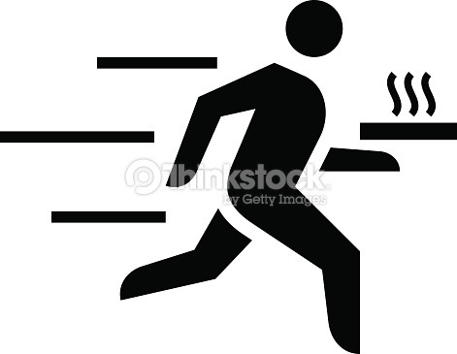


Notes:
Or a smart sports fan could impress his friends by using the app to get more goods delivered to their party room at the match!

Slide 20

$
Upsell!
Notes:
Clients will love the upsell opportunities

Slide 21
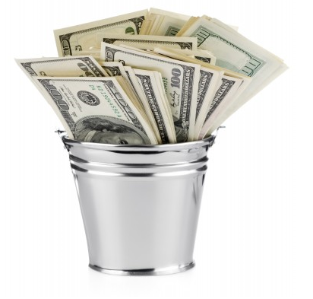
$
YOU!
Notes:
YOU will love selling it because it will make you buckets of money!

Slide 22
Seriously! Go sell it NOW!
Notes:
Did we mention that it leverages existing Ungerboeck Software architecture so it’s ready to sell right now???
SERIOUSLY! Go sell it! NOW! Everything is ready to go for your money making enjoyment!

Slide 23
Any questions?
Notes:
Do you have any questions?

Slide 24
Ask a team member from Los Pollos Locos
Notes:
Be sure to ask a member of Team Los Pollos Locos!

Slide 25
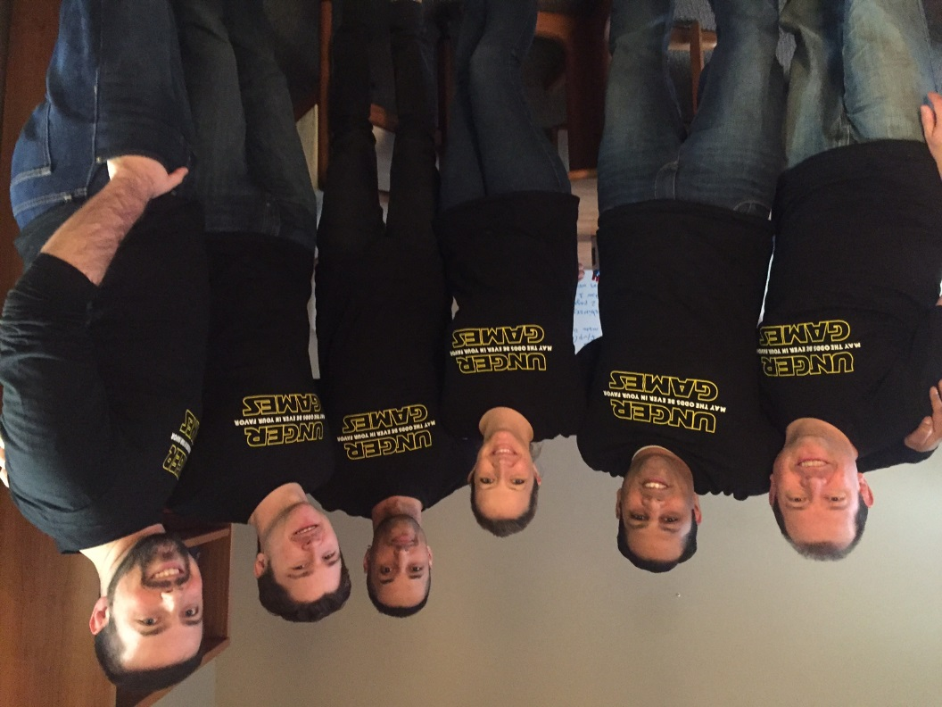
Ask a member of Team Los Pollos Locos
(These guys!)
CLUCK YEAH!
Notes:
These guys! Cluck yeah!

Slide 26
Cater U
U know u want to sell it.
Notes:
The Cater U app. You know you want to sell it!

Slide 27
Thanks for your time.
Notes:
Thank you for your time.

